Slide 1

GAME DEV WITH ALLEGRO 5
Event

Slide 2
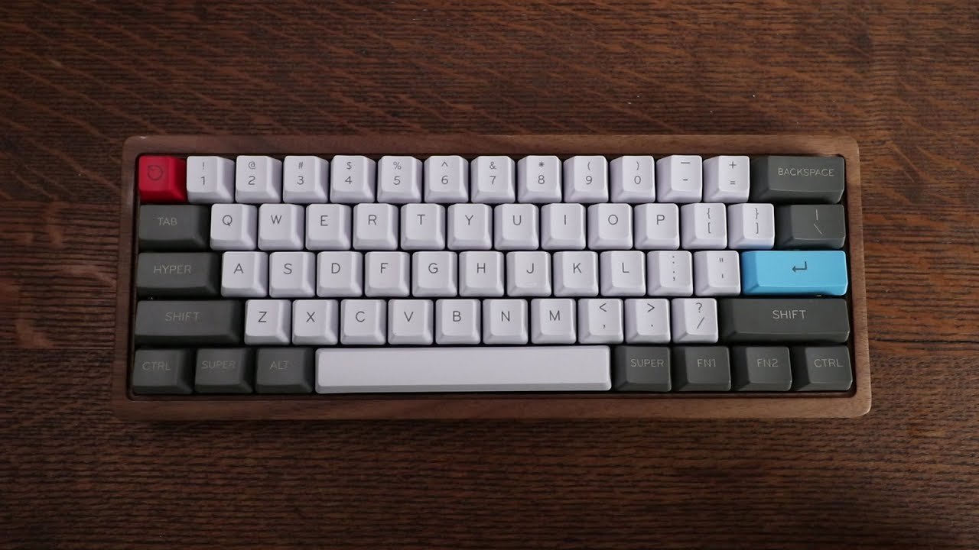

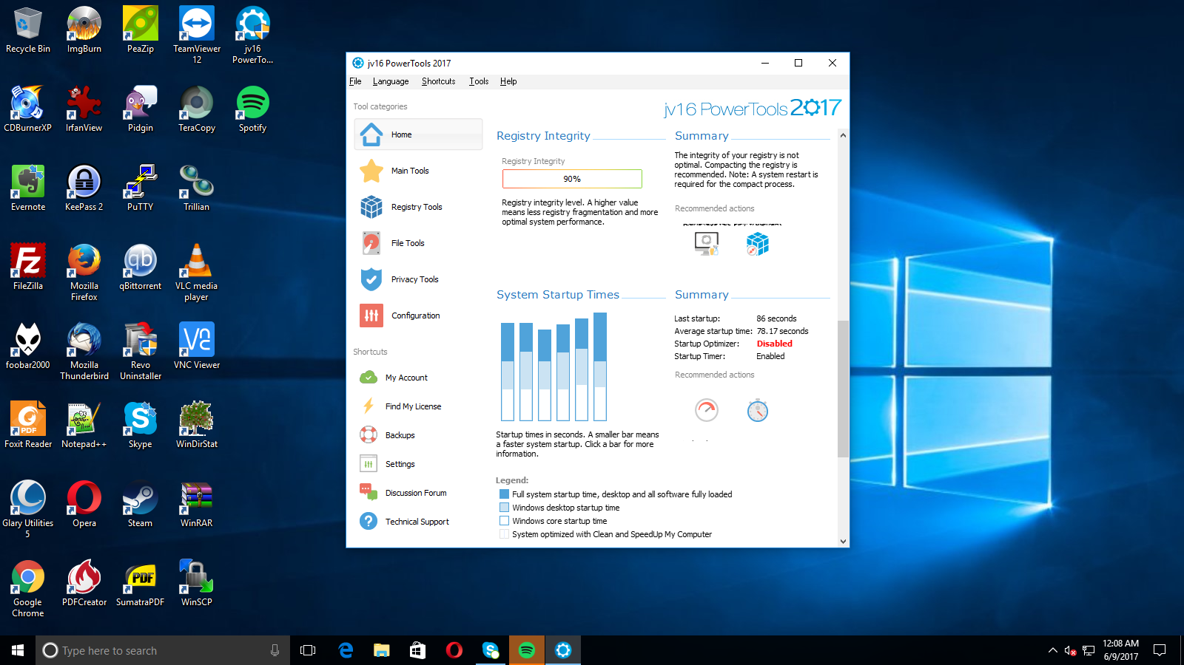
What is an Event?
An action you take or an occurrence that is recognized by the software
Different types of event that will be used in this series
Window Event
Keyboard Event
Mouse Event

